Slide 1
Inheritance
Introduction to Programming II
Lecture 1
Introduction and Overview of Module
Introduction to Inheritance
This lecture and its associated materials have been produced by Mr. Abhinav Dahal (M.Sc., Linnaeus University) of iAcademy for the purposes of lecturing on the above described subject and the material should be viewed in this context. The work does not constitute professional advice and no warranties are made regarding the information presented. The Author and iAcademy do not accept any liability for the consequences of any action taken as a result of the work or any recommendations made or inferred. Permission to use any of these materials must be first granted by iAcademy.

Slide 2
Agenda
Introduction to your Instructors
Introduction to the Module
Week 1 Lecture Coverage
Concept of inheritance
The super keyword
The is-a and has-a relationship
The implements keyword
The instanceof keyword
Types of inheritace
Advantages of inheritance

Slide 3

Module Leader
Abhinav Dahal (M.Sc., Linnaeus, Sweden)
Senior Lecturer, Islington College, Nepal
Previous Appointments
PHP developer, WorldLink Technologies, NP
Chief developer for www.sharesansar.com
Specialization
Java (Core & Advance)
Java Android
PHP

Slide 4

Introduction to the Module
Overview of Module
What can you expect?
Learning Objectives
How will you benefit?
Learning Strategy
How you will learn?
Assessment Overview
How you will be tested?

Slide 5
Overview of Module
This module aims to teach advance Object Oriented Programming concepts to students.
The module will teach students to write, analyze and correct program codes using graphical interface (BlueJ) or any other Integrated Development Environments (IDEs).
At the end of the course, students will be able to write complex programs giving them further knowledge and confidence for computing major.

Slide 6


Learning Objectives
Servlets & JSP
Android
Core Java
Advance Java Programming

Slide 7
Learning Strategy
Taught over 1 semester
Total 12 weeks of class (12 weeks each semester)
Each week consists of 1 Lecture (2 Hours) and 1 lab (2 Hours)
Lecture: Learn how to acquire programming skills.
Lab: Review and practice programming skills through in-class practical exercises to actually acquire them.

Slide 8
Learning Strategy
Attendance for all classes is important!
Programming cannot be learnt by memorizing. It is learnt through constant practice.
We want to provide you the environment to practice and improve effectively.

Slide 9
Assessment Details
Semester
Test 1 (20%)
Test 2 (20%)
Coursework (60%)
Inheritance
Exceptions
Individual
Polymorphism
Threads
Week 14
Recursion
File & Streams
Interface
GUI 1, 2 & 3
Week 5
Week 12

Slide 10
Assessment Details
Module Grading Standards in the UK
Range of Marks | Grade | Remarks
70 - 100 | A | Excellent: outstanding performance with only minor errors
60 - 69 | B | Very Good: above the average standard but with some errors
50 - 59 | C | Good: generally sound work with a number of notable errors
43 - 49 | D | Satisfactory: fair but with significant shortcomings
40 - 42 | E | Sufficient: performance meets the minimum criteria
0 - 39 | F | Fail: performance does not meet the minimum criteria and considerable further work is required

Slide 11
Assessment Details
More Information about the assessments will be provided in subsequent weeks.

Slide 12

Any Questions?

Slide 13

Let’s get started with Lecture 1
An Introduction to Inheritance

Slide 14
Introduction - Inheritance
Inheritance can be defined as the process where one class acquires the properties (methods and fields) of another.
With the use of inheritance the information is made manageable in a hierarchical order.
The class which inherits the properties of other is known as subclass (derived class, child class) and the class whose properties are inherited is known as superclass (base class, parent class).

Slide 15
extends Keyword
extends is the keyword used to inherit the properties of a class.
The syntax for using extends is:
class Super{
..... .....
}
class Sub extends Super{
..... .....
}

Slide 16
Inheritance - Demo
class Calculation{
int z;
public void addition(int x, int y){
z = x+y;
System.out.println("The sum of the given numbers:"+z);
}
public void substraction(int x,int y){
z = x-y;
System.out.println("The difference between the given numbers:"+z);
}
}

Slide 17
Inheritance – Demo (Contd...)
public class My_Calculation extends Calculation{
public void multiplication(int x, int y){
z = x*y;
System.out.println("The product of the given numbers:"+z);
}
public static void main(String args[]){
int a = 20, b = 10;
My_Calculation demo = new My_Calculation();
demo.addition(a, b);
demo.substraction(a, b);
demo.multiplication(a, b);
}
}

Slide 18
Inheritance – Demo (Contd...)
Using extends keyword the My_Calculation inherits the methods addition() and subtraction() of Calculation class.
In the given program when an object to My_Calculation class is created, a copy of the contents of the super class is made with in it.

Slide 19
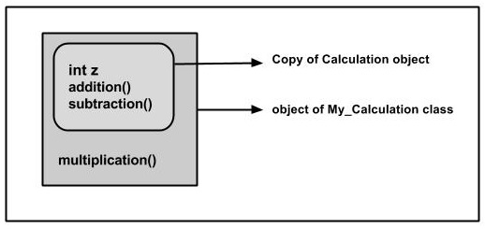
Inheritance – Demo (Contd...)
That is why, using the object of the subclass you can access the members of a super class.

Slide 20
Inheritance – Demo (Contd...)
The Superclass reference variable can hold the subclass object, but using that variable you can access only the members of the superclass, so to access the members of both classes it is recommended to always create reference variable to the subclass.

Slide 21
Inheritance – Demo (Contd...)
If you consider the given example you can instantiate the class as given below as well.
Calculation cal = new My_Calculation();
cal.addition(a,b);
cal.subtraction(a,b);
But using the superclass reference variable ( cal in this case ) you cannot call the method multiplication(), which belongs to the subclass My_Calculation.

Slide 22
Inheritance - Demo
A subclass inherits all the members (fields, methods, and nested classes) from its superclass.
Constructors are not members, so they are not inherited by subclasses, but the constructor of the superclass can be invoked from the subclass.

Slide 23

Any Questions?

Slide 24
The super Keyword
The super keyword is similar to this keyword.
Following are the scenarios where the super keyword is used:
It is used to differentiate the members of superclass from the members of subclass, if they have same names.
It is used to invoke the superclass constructor from subclass.

Slide 25
The super Keyword
Differentiating the members
If a class is inheriting the properties of another class, and if the members of the superclass have the names same as the subclass, to differentiate these variables we use super keyword as shown:
super.variable
super.method();

Slide 26
The super Keyword – Example I
In the given program you have two classes namely Sub_class and Super_class, both have a method named display() with different implementations, and a variable named num with different values.
We are invoking display() method of both classes and printing the value of the variable num of both classes, here you can observe that we have used super key word to differentiate the members of super class from sub class.

Slide 27
The super Keyword – Example I
class Super_class{
int num = 20;
//display method of superclass
public void display(){
System.out.println("This is the display method of superclass");
}
}

Slide 28
The super Keyword - Example I
public class Sub_class extends Super_class {
int num = 10;
//display method of sub class
public void display(){
System.out.println("This is the display method of subclass");
}
Note: please go to the next slide to continue

Slide 29
The super Keyword - Example I
public void my_method(){
//Instantiating subclass
Sub_class sub = new Sub_class();
//Invoking the display() method of sub class
sub.display();
//Invoking the display() method of superclass
super.display(); //printing the value of variable num of subclass System.out.println("value of the variable named num in sub class:"+ sub.num); //printing the value of variable num of superclass
System.out.println("value of the variable named num in super class:"+ super.num);
}

Slide 30
The super Keyword - Example I
public static void main(String args[]){
Sub_class obj = new Sub_class();
obj.my_method();
}
}

Slide 31
The super Keyword
If a class is inheriting the properties of another class, the subclass automatically acquires the default constructor of the super class.
But if you want to call a parametrized constructor of the super class, you need to use the super keyword as shown:
super(values);

Slide 32
The super Keyword - Example II
The program given in this section demonstrates how to use the super keyword to invoke the parametrized constructor of the superclass.
This program contains a super class and a sub class, where the super class contains a parametrized constructor which accepts a string value, and we used the super keyword to invoke the parametrized constructor of the super class.

Slide 33
The super Keyword - Example II
class Superclass{
int age;
Superclass(int age){
this.age = age;
}
public void getAge(){
System.out.println("The value of the variable named age in super class is: " +age);
}
}

Slide 34
The super Keyword - Example II
public class Subclass extends Superclass {
Subclass(int age){
super(age);
}
public static void main(String args[]){
Subclass s = new Subclass(24);
s.getAge();
}
}

Slide 35


Slide 36
IS-A Relationship
IS-A is a way of saying : This object is a type of that object.
Let us see how the extends keyword is used to achieve inheritance.
public class Animal{ }
public class Mammal extends Animal{ }
public class Reptile extends Animal{ }
public class Dog extends Mammal{ }

Slide 37
IS-A Relationship
Now, based on the previous example, In Object Oriented terms, the following are true:
Animal is the superclass of Mammal class.
Animal is the superclass of Reptile class.
Mammal and Reptile are subclasses of Animal class.
Dog is the subclass of both Mammal and Animal classes.

Slide 38
IS-A Relationship
Now, if we consider the IS-A relationship, we can say:
Mammal IS-A Animal
Reptile IS-A Animal
Dog IS-A Mammal
Hence : Dog IS-A Animal as well
With use of the extends keyword the subclasses will be able to inherit all the properties of the superclass except for the private properties of the superclass.

Slide 39
IS-A Relationship
We can assure that Mammal is actually an Animal with the use of the instance operator.

Slide 40
IS-A Relationship
class Animal{ }
class Mammal extends Animal{ }
class Reptile extends Animal{ }
public class Dog extends Mammal{
public static void main(String args[]){
Animal a = new Animal();
Mammal m = new Mammal();
Dog d = new Dog();
System.out.println(m instanceof Animal); System.out.println(d instanceof Mammal); System.out.println(d instanceof Animal);
}
}

Slide 41
The implements Keyword
Since we have a good understanding of the extends keyword let us look into how the implements keyword is used to get the IS-A relationship.
Generally, the implements keyword is used with classes to inherit the properties of an interface.
Interfaces can never be extended by a class.
Interfaces will be studies in Lecture 4.

Slide 42
The instanceof Keyword
The java instanceof operator is used to test whether the object is an instance of the specified type (class or subclass or interface).
The instanceof in java is also known as type comparison operator because it compares the instance with type.
It returns either true or false.

Slide 43
HAS-A relationship
This relationship is mainly based on the usage.
This determines whether a certain class HAS-A certain thing.
This relationship helps to reduce duplication of code as well as bugs.

Slide 44
HAS-A relationship
Lets us look into an example:
public class Vehicle{}
public class Speed{}
public class Van extends Vehicle{
private Speed sp;
}

Slide 45
HAS-A relationship
This shows that class Van HAS-A Speed.
By having a separate class for Speed, we do not have to put the entire code that belongs to speed inside the Van class, which makes it possible to reuse the Speed class in multiple applications.

Slide 46
HAS-A relationship
In Object-Oriented feature, the users do not need to bother about which object is doing the real work.
To achieve this, the Van class hides the implementation details from the users of the Van class.
So basically what happens is the users would ask the Van class to do a certain action and the Van class will either do the work by itself or ask another class to perform the action.

Slide 47
Any Questions?

Slide 48
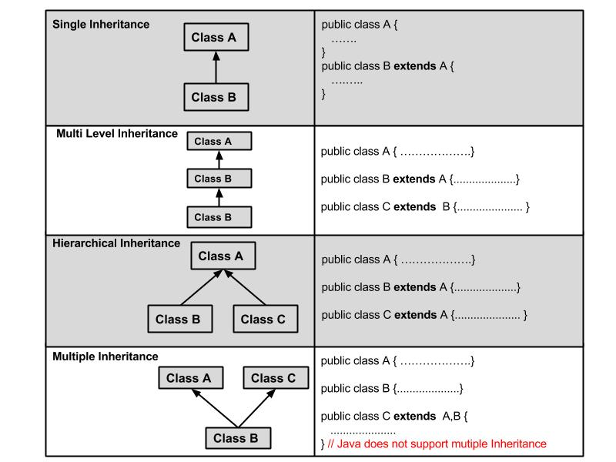
Types of Inheritance

Slide 49
Types of Inheritance
A very important fact to remember is that Java does not support multiple inheritance.
This means that a class cannot extend more than one class.
Therefore following is illegal:
public class extends Animal, Mammal{}
However, a class can implement one or more interfaces.
This has made Java get rid of the impossibility of multiple inheritance.

Slide 50
Advantages of Inheritance
Avoiding code duplication
Easier maintenance
Extendibility

Slide 51
Summary: Week 1 Lecture
Concept of Inheritance
Example of Inheritance Hierarchies
Inheritance in Java
Advantages of Inheritance
The Object Class
Invoking Superclass Constructor
The instanceof Operator
Types of Inheritance
Multiple Inheritance

Slide 52
What to Expect: Week 1 Lab
Discussion about the topics covered in the lecture.
Provide practical questions based on inheritance so it is vital that you go through the lecture slide!!.

Slide 53


